Slide 1
NSA Codebreakers Challenge
Bernie Lampe
Notes:
Annual recruiting event put on by NSA specifically targeting colleges and universities (.edu email required).
https://codebreaker.ltsnet.net/home

Slide 2
Overview
Yearly NSA recruiting CTF-like event
Sept 5, 2016 to Dec 31, 2016
Six levels that build on one another
Progress to next level sequentially
Exponentially more difficult levels
Motivating story is defeating IED software
To stop terrorists of course
Linux guy so this will have a Linux slant
Notes:
Built around a continuous story about software for an IED. Each level gives you a little more of the story and a new binary to analyze.
Levels 1 to 4 were pretty easy for people already in the VR field.
Levels 5 and 6 were challenging due to the amount of reversing and cracking needed.
Each level has a Windows and Linux binary. You can analyze either. I’m a Linux guy so I chose the latter.

Slide 3
Game Map – 6 Levels
Client
PE, ELF
TCP Traffic
PCAP
Server
PE, ELF
H/W Driver
DLL, SO
Key Gen
PE, ELF
H/W Sim
PE, ELF
Pipe / PTY
Binary Reversing
Network Traffic Analysis
Public/Private Key Pair
Crypto Cracking
Static/Dynamic Analysis
Malware Reversing
Notes:
This is a map I made up to explain the game. The challenge type is roughly categorized below the diagram. I’ll refer back to this map through the presentation to ground the discussions.
Level 1 gives you the client binary.
Level 2 gives you the TCP traffic in a PCAP.
Level 3 gives you the server binary, a dummy driver and a key file.
Level 4 uses the same binaries you have so far.
Level 5 gives you the key gen binary.
Level 6 gives you a real driver and a hardware simulator.

Slide 4
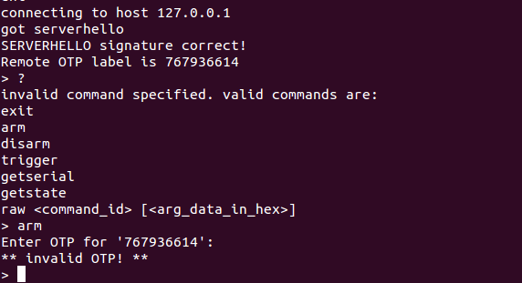
Client
The Client Program
Connecting to the server obtained in later stage

Slide 5
Server
The Server Program
Validates the client signature and commands
Computes and validates OTPs
Relays commands to the hardware driver
Requires an encrypted key file which is keyed to the specific IED serial number
IED serial number optionally taken from the env and matched with the decrypted key on startup

Slide 6
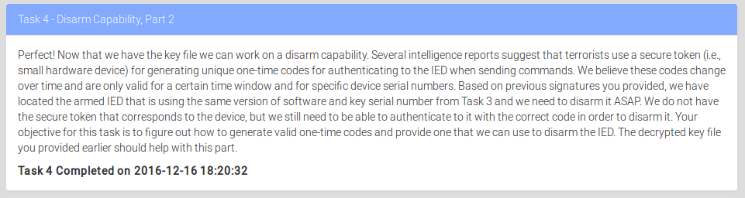
Task 4: Disarm an IED with the key
Given a valid keyfile and a dummy driver, generate the valid OTP
OTPs are time based
Notes:
Goal of level 4 is to generate a one-time password (OTP) for the client, server, driver, keyfile you have.
The OTPs rotate with time.
This level answers the questions of “can you reverse statically and/or dynamically?” and “can you write a cracker program to make OTPs?”
Knowledge of how server/clients are written in C code is very helpful in this challenge.
This level is moderate and a typical problem in CTF challenges.

Slide 7
Task 4 - Hypothesis
The server is validating OTP’s somewhere. Is it computing them?
Find the validation function and use a debugger to print them?
Think about how client and server interact to reduce code to look at
Build and refine mental model of how server works through iterative dynamic/static reversing/analysis
Server Process
Session loop
Client connect / hello
recv() loop
Client Process
OTP/command in TCP packet
Compute and/or validate OTP
send() error “bad OTP”
Notes:
First thing we do is hypothesize that the server must be computing OTP’s somewhere and that OTP’s will be in memory in the server application.
We just need to find where the OTP’s are computed, then used gdb to print them out.
Next thing we do is imagine how the client to server interaction works and find the sessions loop.
Then follow the data down to where the client’s OTP is compared to the server’s OTP.
Also, narrow down the amount of code we need to look at as soon as possible.

Slide 8
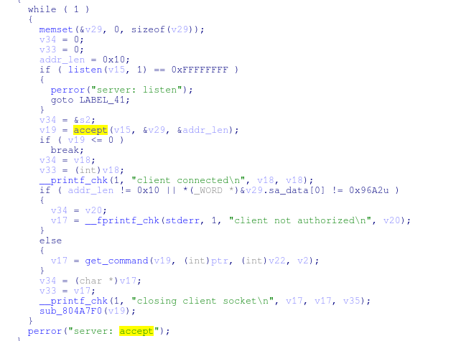
Task 4 - Solution
Found the session management loop by breaking on accept()
The work for each session is done in its own function
accept() per session loop
Notes:
Run the server and attach gdb and breakpoint on accept().
Run the client and record where breakpoint is hit.
Reverse the accept/session loop in IDA.
Notice a function call where the accept file descriptor is sent. Labeled it as “get_command()”.
Brought HexRays to bear on the problem. HexRays is good to navigate large software programs fast, but it is full of inaccuracies. It works well with x86, but not so well with other architectures. You get used to where HexRays is good/bad and learn to read really difficult code. Also, very costly for people not in the industry.

Slide 9
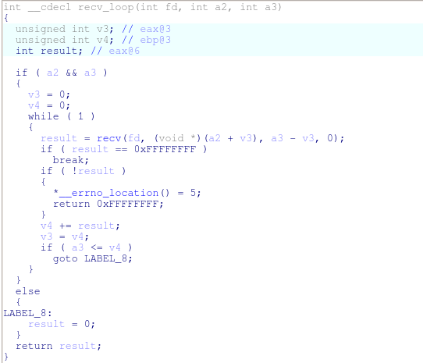
Task 4 - Solution
Break on recv() calls and get xrefs to this function
Try to find when/where the data of interest is read into memory
Notes:
Break on the recv() call and then follow the cross references.
Try to find where our data is read

Slide 10
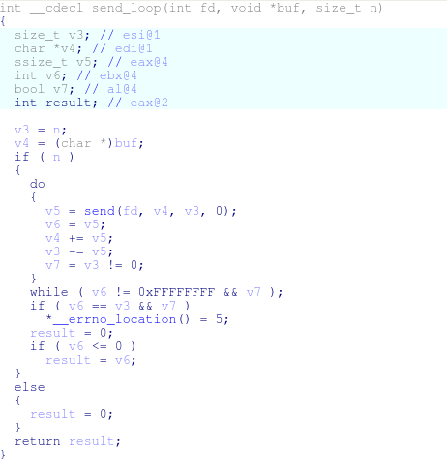
Task 4 - Solution
Break on send() call and see which send informs our client of failure
When the client reports failure we know we have our send, then work backwards
Notes:
Break on send and see which send results in the client informing us of a bad OTP
Assuming the code path is linear, we are bracketing the code between recv() and failure send() to find the place OTPs are compared.

Slide 11
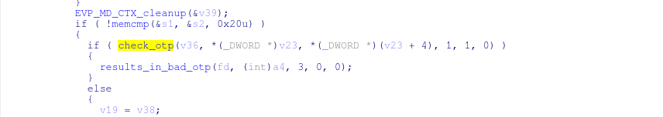
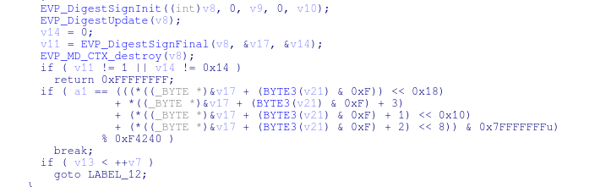
Task 4 - Solution
Worked backwards to this conditional
Shallow function with complicated math, time(0) call and comparison
Set gdb break point at comparison and print numbers
Validate that this is the OTP comparison by entering 43690 = 0xAAAA and checking values in regs at bp
Notes:
Walking up the send() failure stack we find a conditional in the get_command() (top level) function.
This conditional is based on a function call which I named “check_otp()”
check_otp() makes a call to time(0) and does complicated math and finally compares a DWORD read from the client to something computed in the server.
Set breakpoints on the comparison.
Little quirk is that the last three OTPs are computed and compared to the one input into the client.

Slide 12
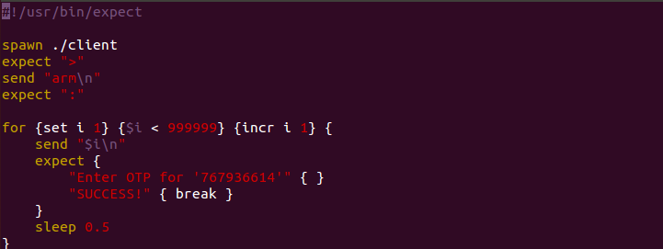
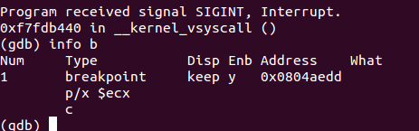
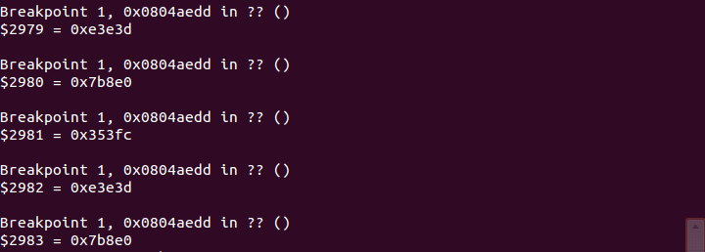
Task 4 - Solution
Too lazy to write a OTP crack program
Wrote an expect script to drive client and some GDB bp commands
Notes:
Too lazy to actually write a cracker program. Would require more reversing and time to validate the cracker.
Wrote and expect script to drive the client and some simple gdb commands to print the OTPs in real time.
Had to try a few times in the game server, but finally got one to go.

Slide 13
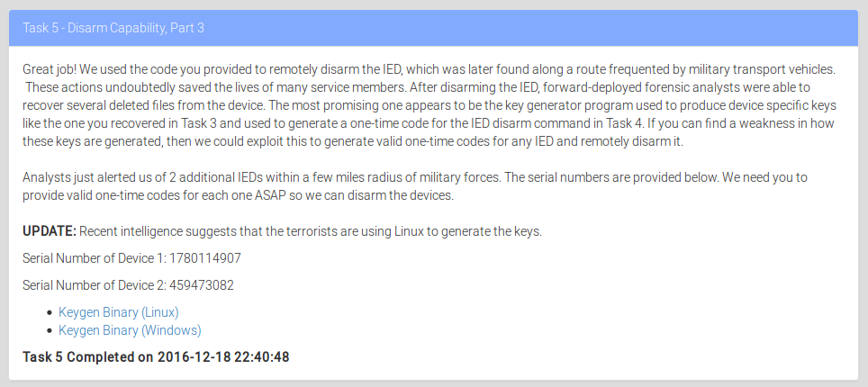
Task 5: Disarm any IED without a key
Without keyfiles, and given the keygen, create valid OTPs
Two IED serial numbers are given
Notes:
Goal is to generate valid OTPs for any IED. Specifically for the serial numbers listed.
They provided a keygen binary.
Apparently the OTPs are specific to a particular serial number.
I consider this a difficult level for a CTF. Must understand and reverse the keygen and then crack the master key file.

Slide 14
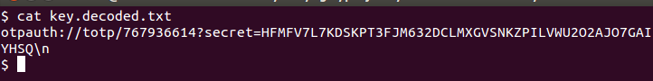
Keygen
Keygen Program
Used to create encrypted server keys for IEDs
Must provide the IED serial number
Uses a master key file as key seed (we don’t have this)
Keys are encrypted with pub/priv pair
Decrypted key
IED Serial Number
Key links MKF and IED Serial

Slide 15
Task 5 - Solution
The key generating infrastructure
IED Serial number
Random data source
Master key file (MKF)
SHA256 algorithm / Based 64
RSA public key
SHA256 algorithm
x1024
Plaintext Server key
OpenSSL rsautil
Input
Algorithm
Output/input to next stage
Encrypted server key
Notes:
Key infrastructure overview
Random data is fed into the SHA256 algorithm to generated a master key file
The master key file and the IED serial number are fed into another algorithm to generate a server key
The server key is protected by the public/private key pair and then used by the server
Random data comes from time(0), IED serial number comes from problem statement, RSA public key comes from the client

Slide 16
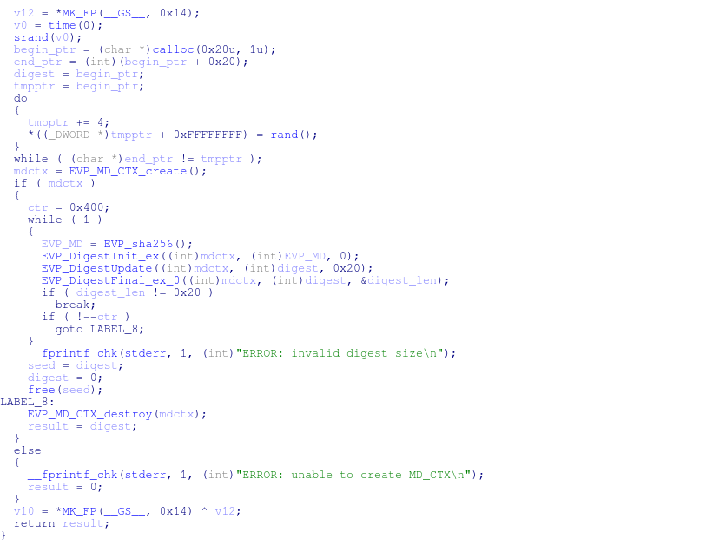
Task 5 - Solution
Reversing the keygen binary
Added all the symbols used from OpenSSL
Found the master key generate function
Generate random data
SHA256 encode 1024 times
Notes:
Reversing the keygen

Slide 17
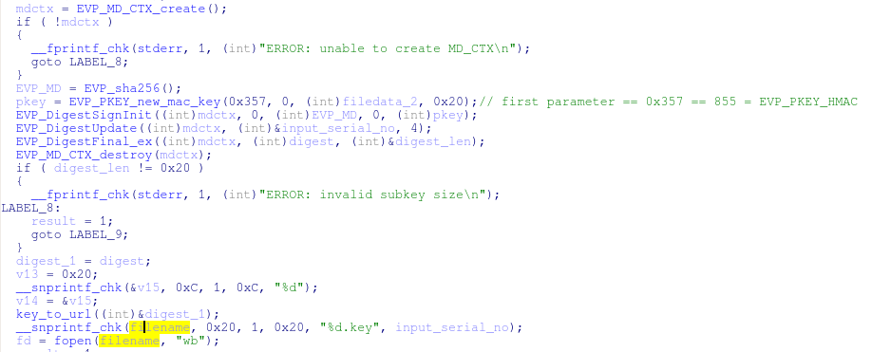
Task 5 - Solution
Reversing the keygen binary
Traced the master file data and input serial number through the program
Notes:
Reversing the keygen

Slide 18
Task 5 - Solution
We have all inputs except the seed to generate the random data
The seed is generated with time(0)
Assume all IEDs use same MKF
Brute force algorithm to find time when the IED MKF was generated
Override srand(seed) to increment through the seeds in keygen
Run keygen –g to make a new MKF on each iteration
Use the serial / server key file from task 3 as stopping criteria
When we generate that file, we know we are done
Narrow down the range of seeds to search by starting with the day before contest
Sep 4, 2016

Slide 19
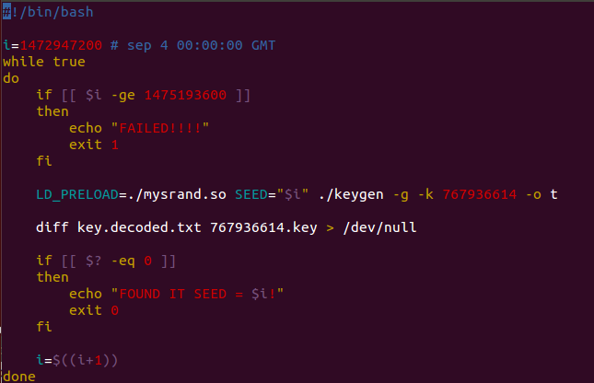
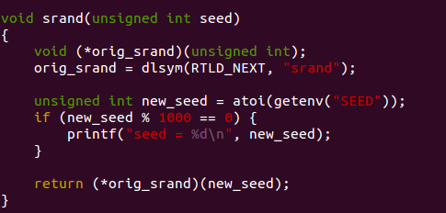
Task 5 - Solution
Simple shell script to brute force the seed along with LD_PRELOAD

Slide 20
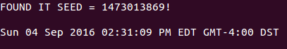
Task 5 - Solution
Found it in about 10 minutes
Generate two keys, one for each serial number
Proceed just like in task 3 to print the OTPs
Run the servers/client drivers simultaneously using expect script
Two instances of server on same machine
Ports 41266 / 8080 conflict
Modify the client and server binaries to bind to different ports
My favorite binary editor is bvi

Slide 21
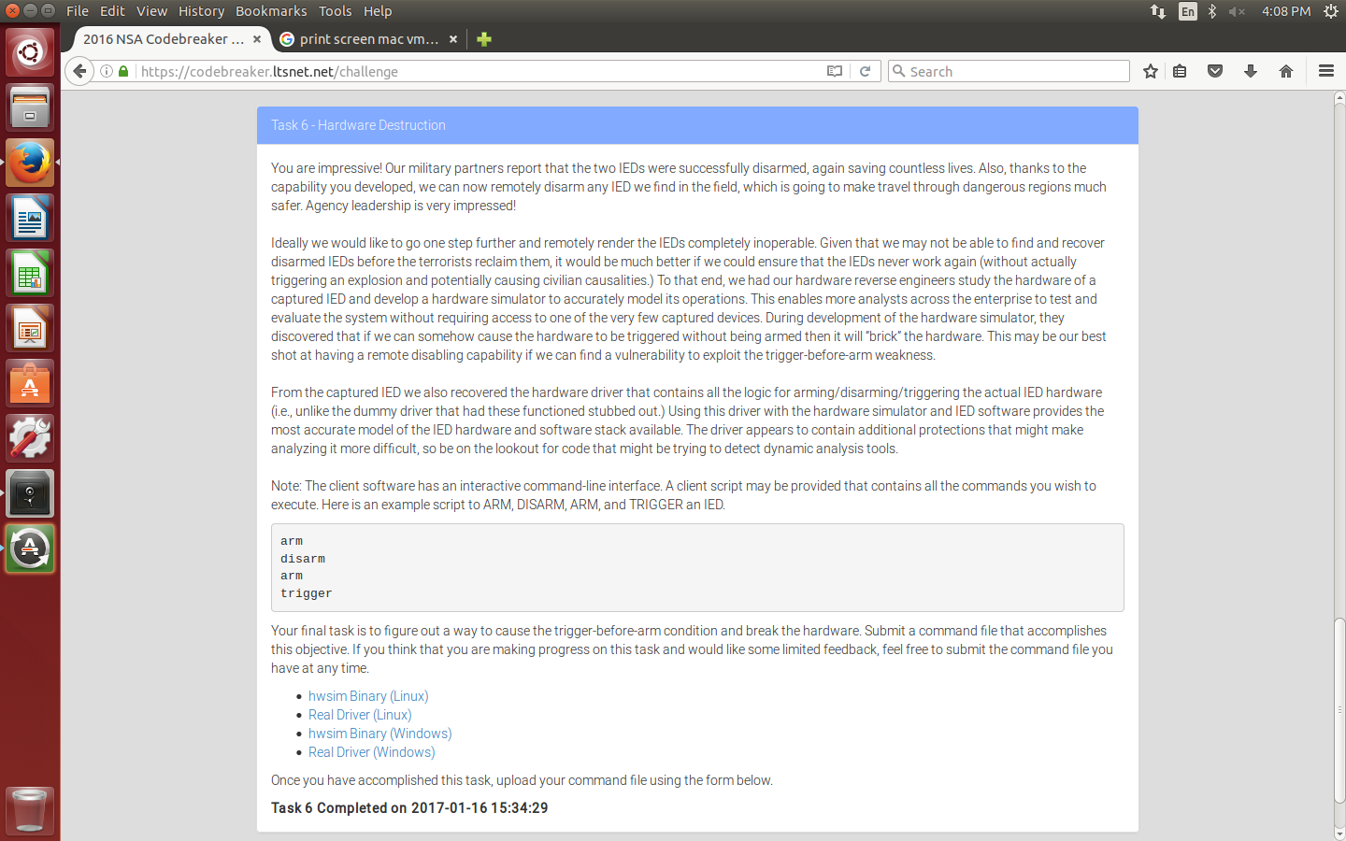
Task 6: Permanently disable any IED
Write client program to cause trigger before arm in hwsim
Notes:
Goal is, from the client, trigger the hardware simulator before it is armed which effectively bricks the machine.
They provide a hwsim binary and a captured / real driver shared object to run it.
They also warn the driver program will have, at least, some dynamic analysis tool detection to make it harder to debug.
Turned out to be more like malware with disassembly obstacles, red herrings, two debugger checks, pointer xor’ing, SEH (for Linux) to make code flow really hard to follow and analyze along with a custom interpreter / virtual machine to do the actual work. These are all text book techniques.
I consider this problem hard and it took me a while.

Slide 22
Client
The Client Commands

Slide 23
Driver
The Driver Shared Object
In charge of the hardware state machine
Shouldn’t issue “trigger” command if not in “armed” state
Knows how to run the hardware
Lots of anti-debugging and anti-reversing here

Slide 24
HW Sim
The Hardware Sim Program
Accepts commands over serial device from driver
Simple state machine
The story line says this program was constructed by reversing a real IED chipset
You can ”brick” the chipset if you trigger w/o arm

Slide 25
Task 6 - Solution
Goal is to write a client script that will cause hwsim to brick
Trigger without arming
No OTPs in this level
Reversing libdriver.so
Too much reversing to take you all the way through my thought process
Detail the highlights of reversing, anti-reversing, anti-debugging and the interpreter
Turned out to be academic examples of malware
disassembly obstacles
red herrings
two debugger checks
pointer obfuscation via XOR’ing
SEH (ported to Linux) to make code flow hard to follow
custom interpreter / virtual machine to do the actual work
run length encoded interpreter program
subtle bug in interpreter

Slide 26
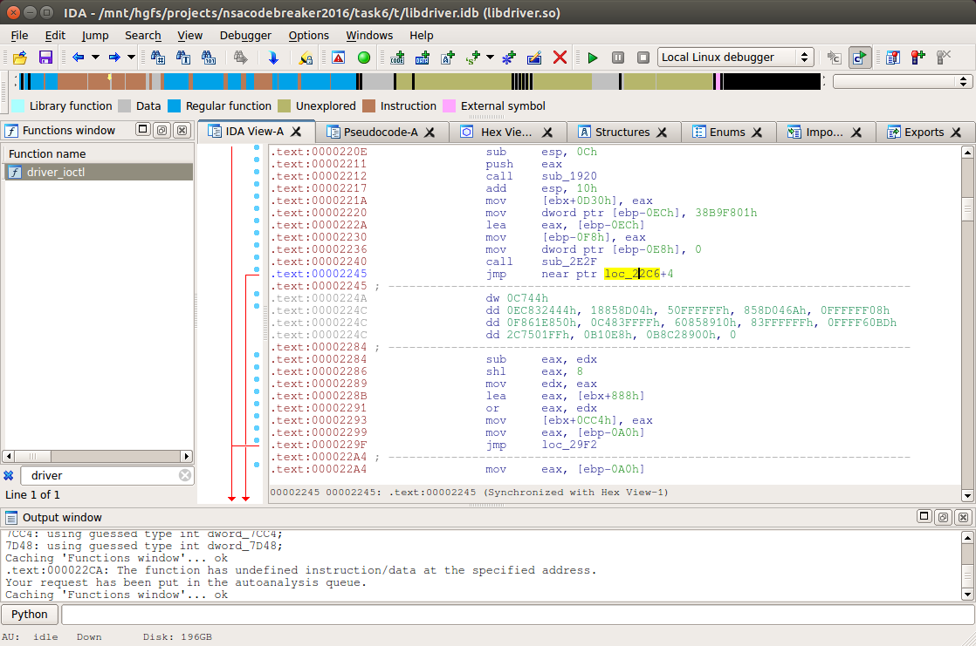
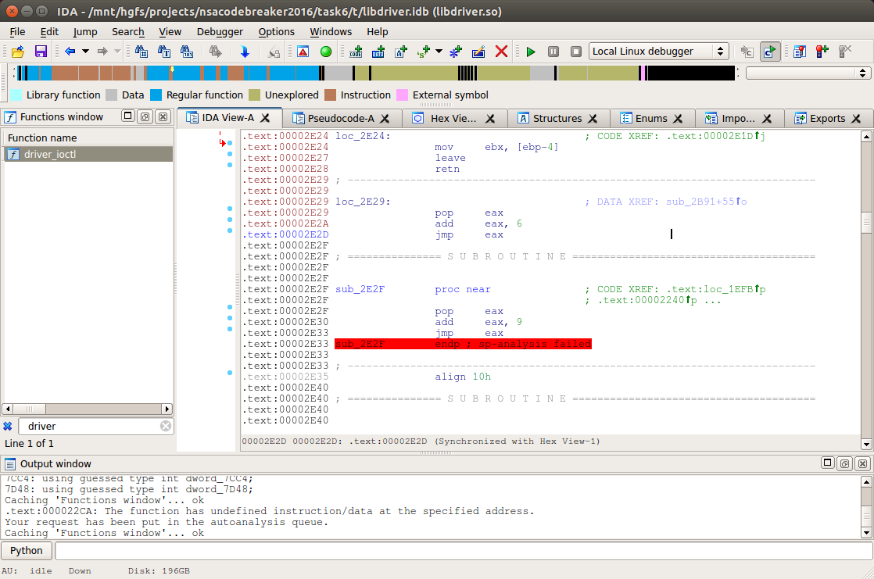
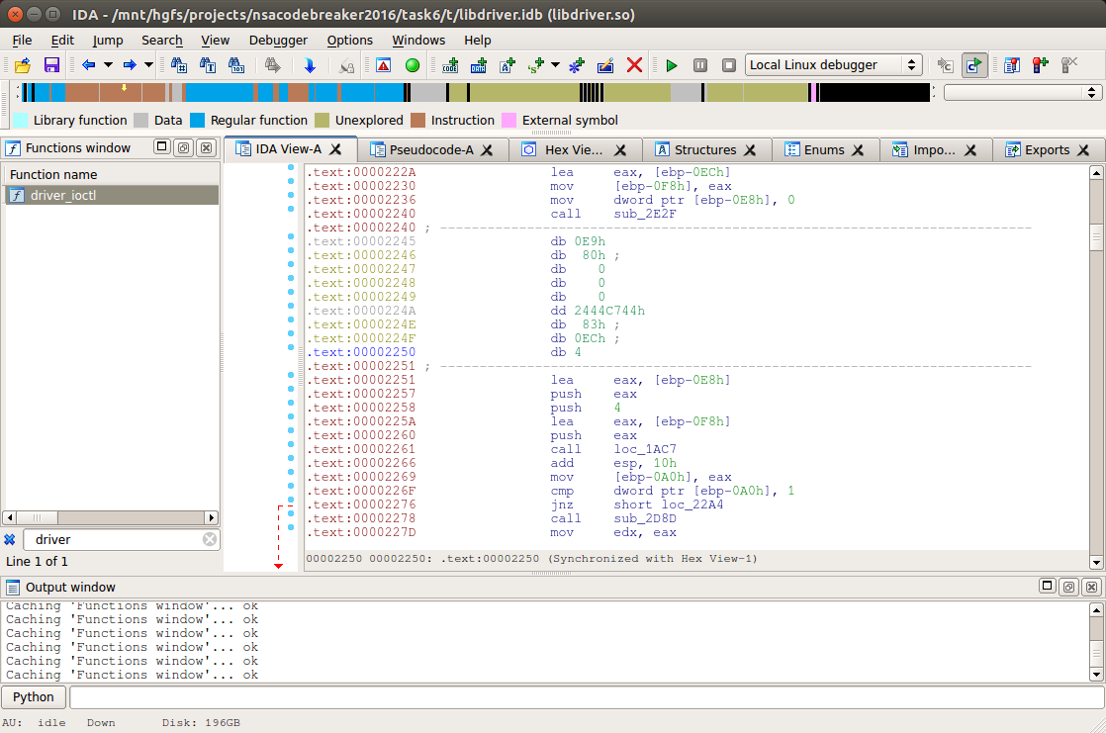
Task 6 - Solution
Disassembly obstacles
Classic jump to the middle of another instruction and put in junk instruction bytes
Prevents creating of functions
Notes:
First thing to notice when browsing the disassembly is that the recursive decent disassembler from IDA missed a bunch of code space. Suggests indirect calls.
Also, that some functions could not be created due to control flow confusion.

Slide 27
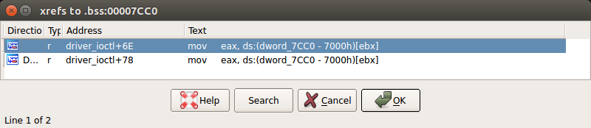
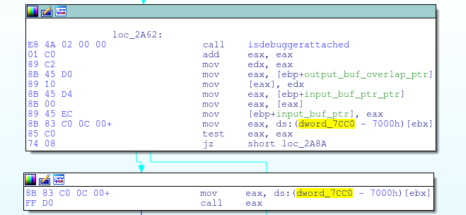
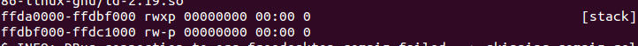
TASK 6 - Solution
Some red herrings I ran into
First one was a global function pointer which was checked then called
The second was a rwx stack
Notes:
The code has two red herrings that threw me off a bit.
The first is that the server process has an executable stack. I interpreted that as a nod towards a stack overflow.
The second is a check and call to a pointer that is on the BSS. I took that as something which can be used if we had a relative OOB write.

Slide 28
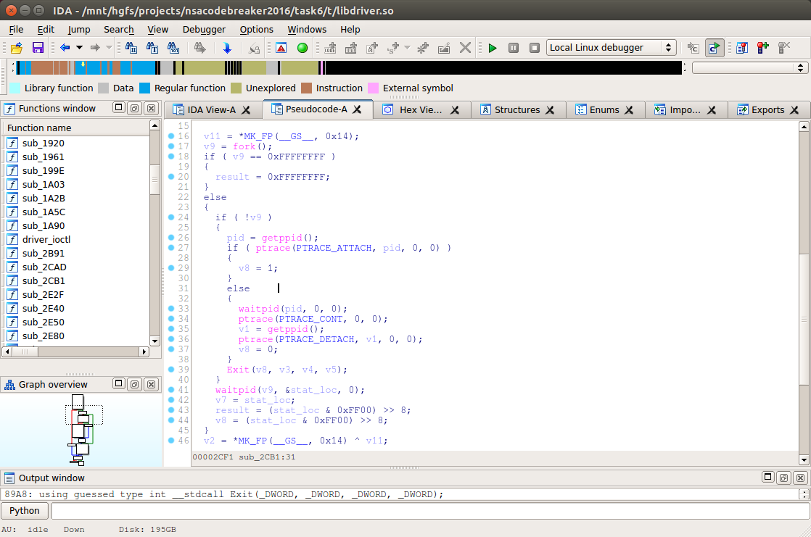
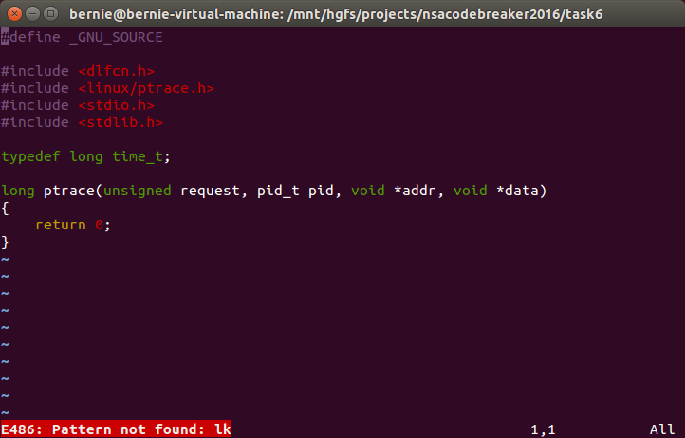
Task 6 - Solution
Debugger check
Call to fork() to make a new child process and then tries to ptrace the parent process
Easy to overcome with LD_PRELOAD
Notes:
libdriver.so is full of anti-debugging and anti-disassemly/reversing code
First debugger detection check does a fork() ptrace()
Easily bypassed with LD_PRELOAD.

Slide 29
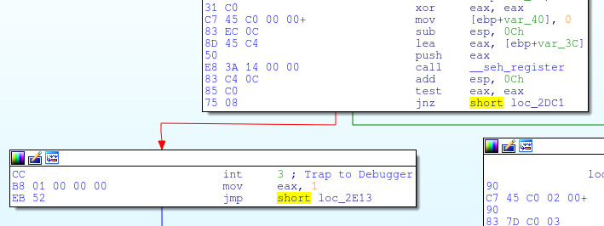
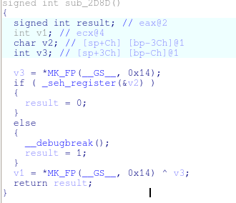
Task 6 - Solution
Debugger check
Ran into another anti-debugger check later on
Edit the binary to remove 0xCC and return 0
Register signal handler
Interrupt here throws an exception
Notes:
Another debugger check function does an int 3.
This is caught with a debugger if one is attached and the debugger proceeds just below the int 3.
Notice the register exception handler above it. If the program handles the exception, then the function returns 0.
If a debugger handles the exception then the function returns 1.

Slide 30
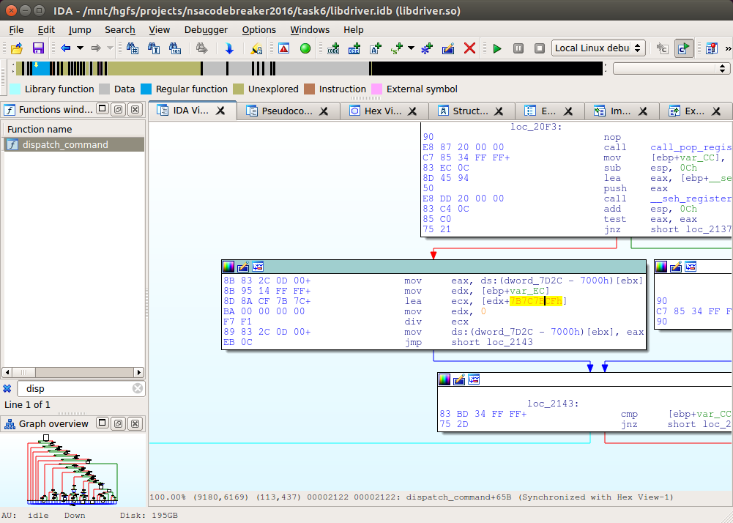
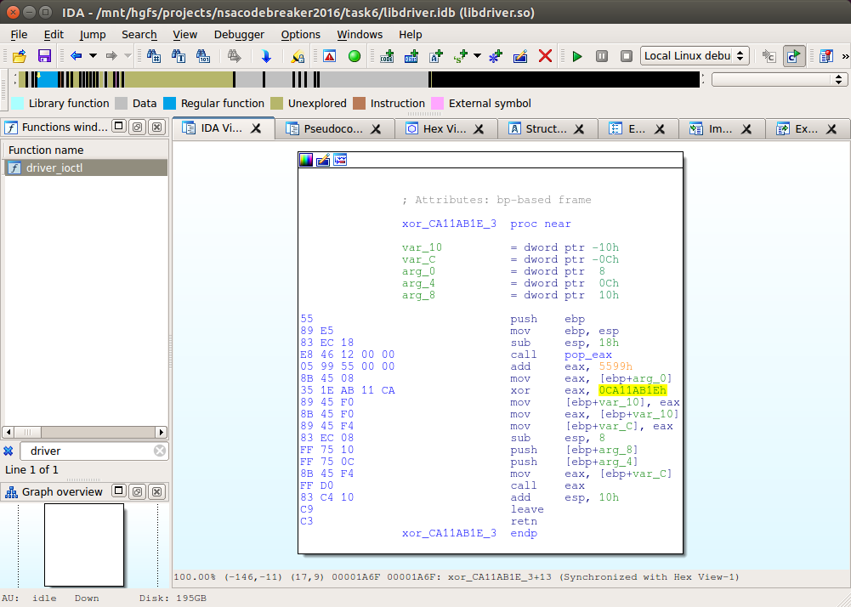
Task 6 - Solution
Integer overflows to invoke certain control flow
Function pointer obfuscation via XOR’ing with 0xCA11AB1E
Notes:
While reversing I ran into a couple oddities which were poor obfuscations
One was integer overflows to get into the maintenance mode
I also think the integers were different between programs, that way an answer couldn’t be trivially shared
The other was pointer XOR’ing which were almost immediately un-XOR’ed to be used

Slide 31
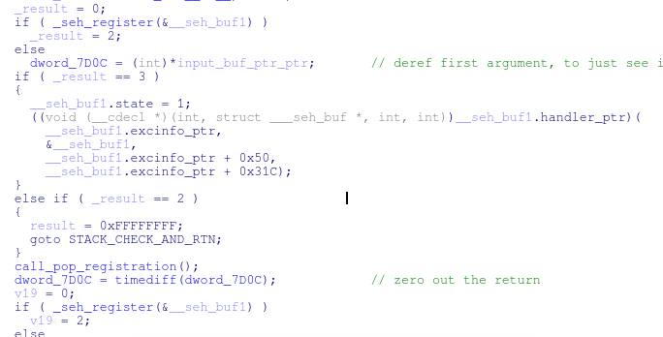
Task 6 - Solution
Exception handling used to implement logic
Thwarts IDAs recursive descent disassembler and obfuscates the logic flow
SEH port to Linux by overriding the signal handlers written by Tom Bramer
http://www.programmingunlimited.net/siteexec/content.cgi?page=libseh

Slide 32
Task 6 - Solution
Interpreter implements generic read, decode, execute loop
Each opcode matches to a handler function
The memory pointer is bound checked on each instruction
Memory is cleared on each program (except in maintenance mode)
1024 DWORDs of memory
Interpreter state struct
Instruction ptr
Memory ptr
Low memory bound
……………….
High memory bound
HW Status DWORD

Slide 33
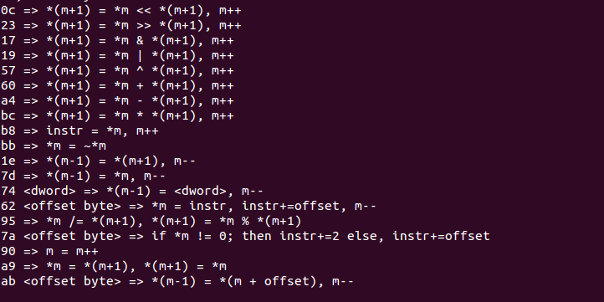
Task 6 - Solution
Reversed interpreter opcodes

Slide 34
Dispatch Overview
int vm_mem[0x200];
int ioctl() {
if (10 bad commands) arm and trigger
else dispatch()
}
int dispatch() {
/* check all argument pointers are valid */
/* if command len % 3 == 0 then fail */
/* case 1: get the hardware status DWORD */
/* case 2: get hardware serial in normal mode */
/* case 3: disarm and change from normal to testing mode */
/* case 4: change mode from testing to normal mode and reset hardware status DWORD */
/* case 5: run the vm in testing mode with our instructions */
/* case 6: run the vm in normal mode and write to hardware (normal path) */
}

Slide 35
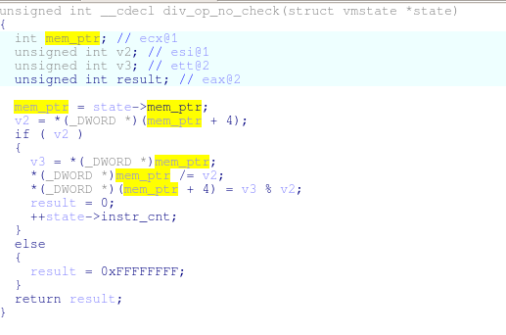
Task 6 - Solution
Subtle bug in the divide opcode function handlers
No bounds checking
Allows read divisor and stored remainder to be one DWORD OOB

Slide 36
HW Status DWORD
0th byte is disarm code
1st byte is armed
2nd byte is trigger
3rd byte is the command to run
It must match one of the other bytes
Bytes are numerically descending
Disarm Code
>
Armed
Code
>
Trigger
Code

Slide 37
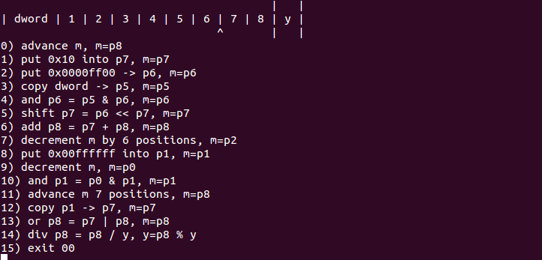
Task 6 - Solution
Final answer interpreter program in short hand

Slide 38
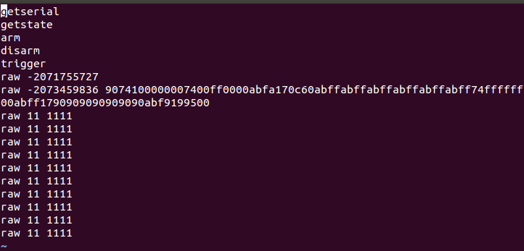
Task 6 - Solution
Final answer
First 5 commands run the interpreter legitimately and leave state data in memory
6th command changes to maintenance mode so we can run interpreter with our program
7th command is interpreter program that does OOB write
Remaining commands fail and trigger an automatic arm-trigger mode
Notes:
First 5 commands are to get stale values into the interpreter memory
The 6th command is the switch to maintenance mode
The 7th command is to run the virtual machine and do the overwrite
The last 10 commands all have lengths as a factor of 3, therefore they fail and trigger a default, arm-trigger cycle which does not overwrite the status DWORD

Slide 39
Game Review
How does it compare to real life?
Pros
Demonstration of practical skills and tools
Good use of red herrings and false leads
Cons
Real problems have many more shared objects
Much bigger, less symbols and strings
Left out some more advanced memory manipulation tech
Heap grooming, shell code writing, return-oriented programming
Typical malware uses only a few obfuscation techniques

Slide 40

Letter from Adm. Rogers

Slide 41
Fin
Questions

